Slide 1

🩺 My Health Tracker
Name:
Course: DLBCSPJWD01 — Web Development
Phase 2: Development & Presentation

Slide 2
What is My Health Tracker?
My Health Tracker is a full-stack web application that allows a user to keep a history of his health habits on a day-to-day basis. It has a user-friendly interface to record the meals, water salary, mood, and exercise, and shows trends in a graphical display to promote healthy habits.
Target Users:
All adults aged 18-45 who need to develop wellness habits that are sustainable.

Slide 3
Core Features
Tracking meals, working out, mood and water consumed
Entries saved on time-stamps automatically
Chart.js water intake graph
List of all logs where deletion is done
Data stored by Atlas MongoDB in persistent storage

Slide 4
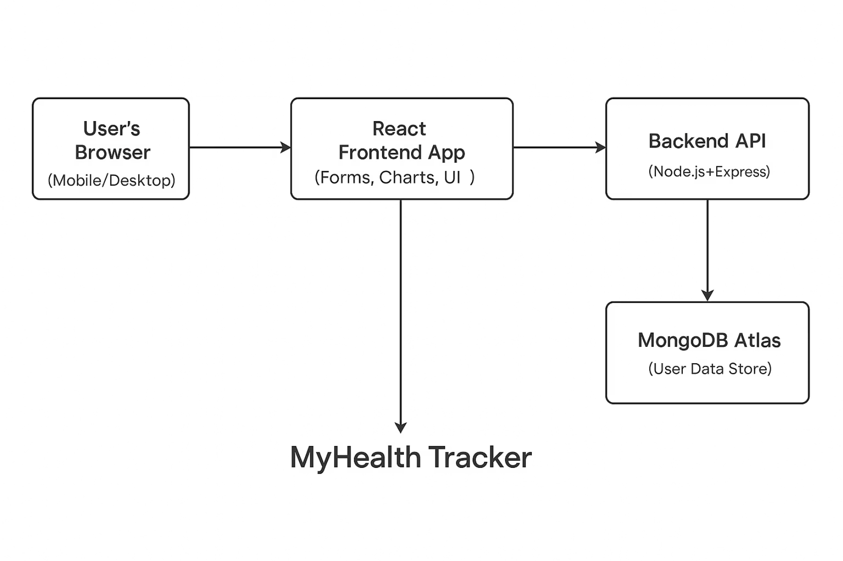
How It Works (Architecture)
The React frontend is used to log in by the user
React posts/accepts data through Axios to a Node.js + Express back end
Backend reaches MongoDB Atlas to store log information
Chart.js visualization

Slide 5
Tech Stack and Tools
Frontend:
React.js (UI)
Chart.js (Visualizations)
Backend:
Node.js + Express (REST API)
MongoDB Atlas (Database)
Other Tools:
Axios (HTTP requests)
dotenv (Environment config)
VS Code (Development)
GitHub (Version control)

Slide 6
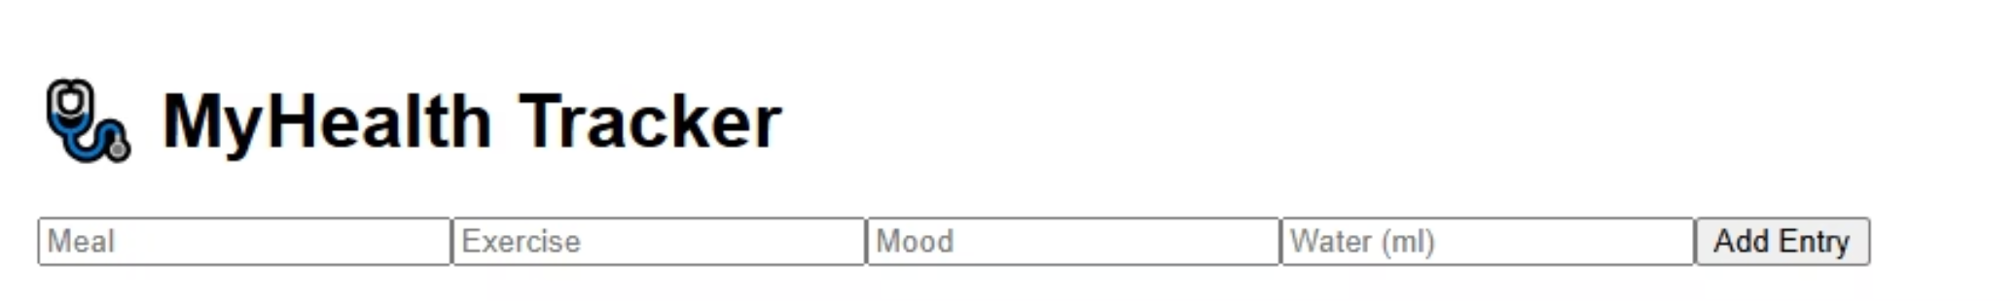
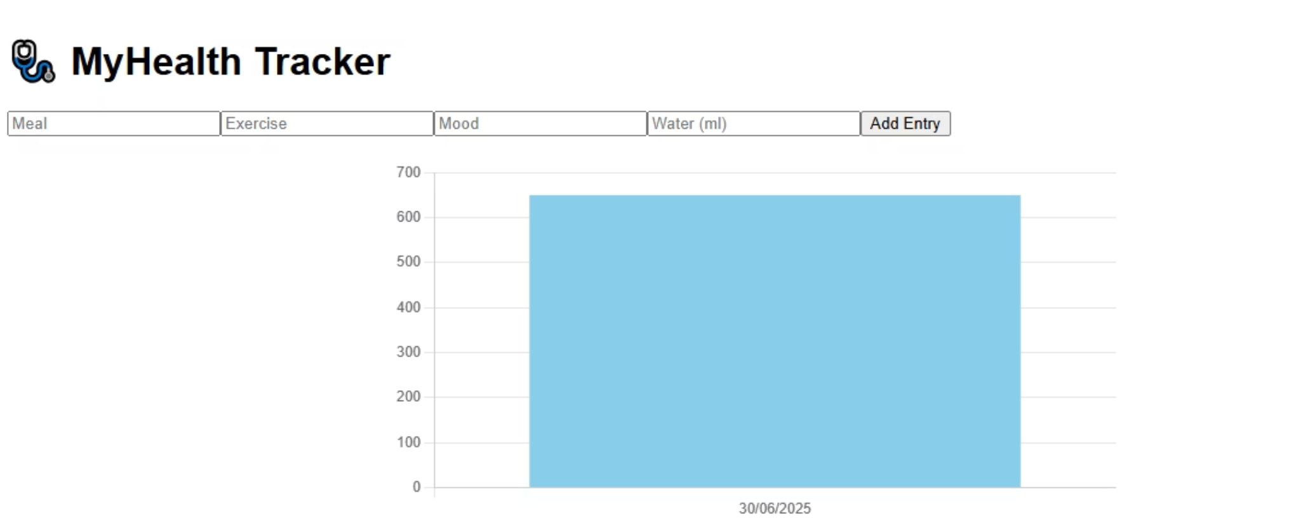
Screenshots from the App
Form:
Chart:

Slide 7
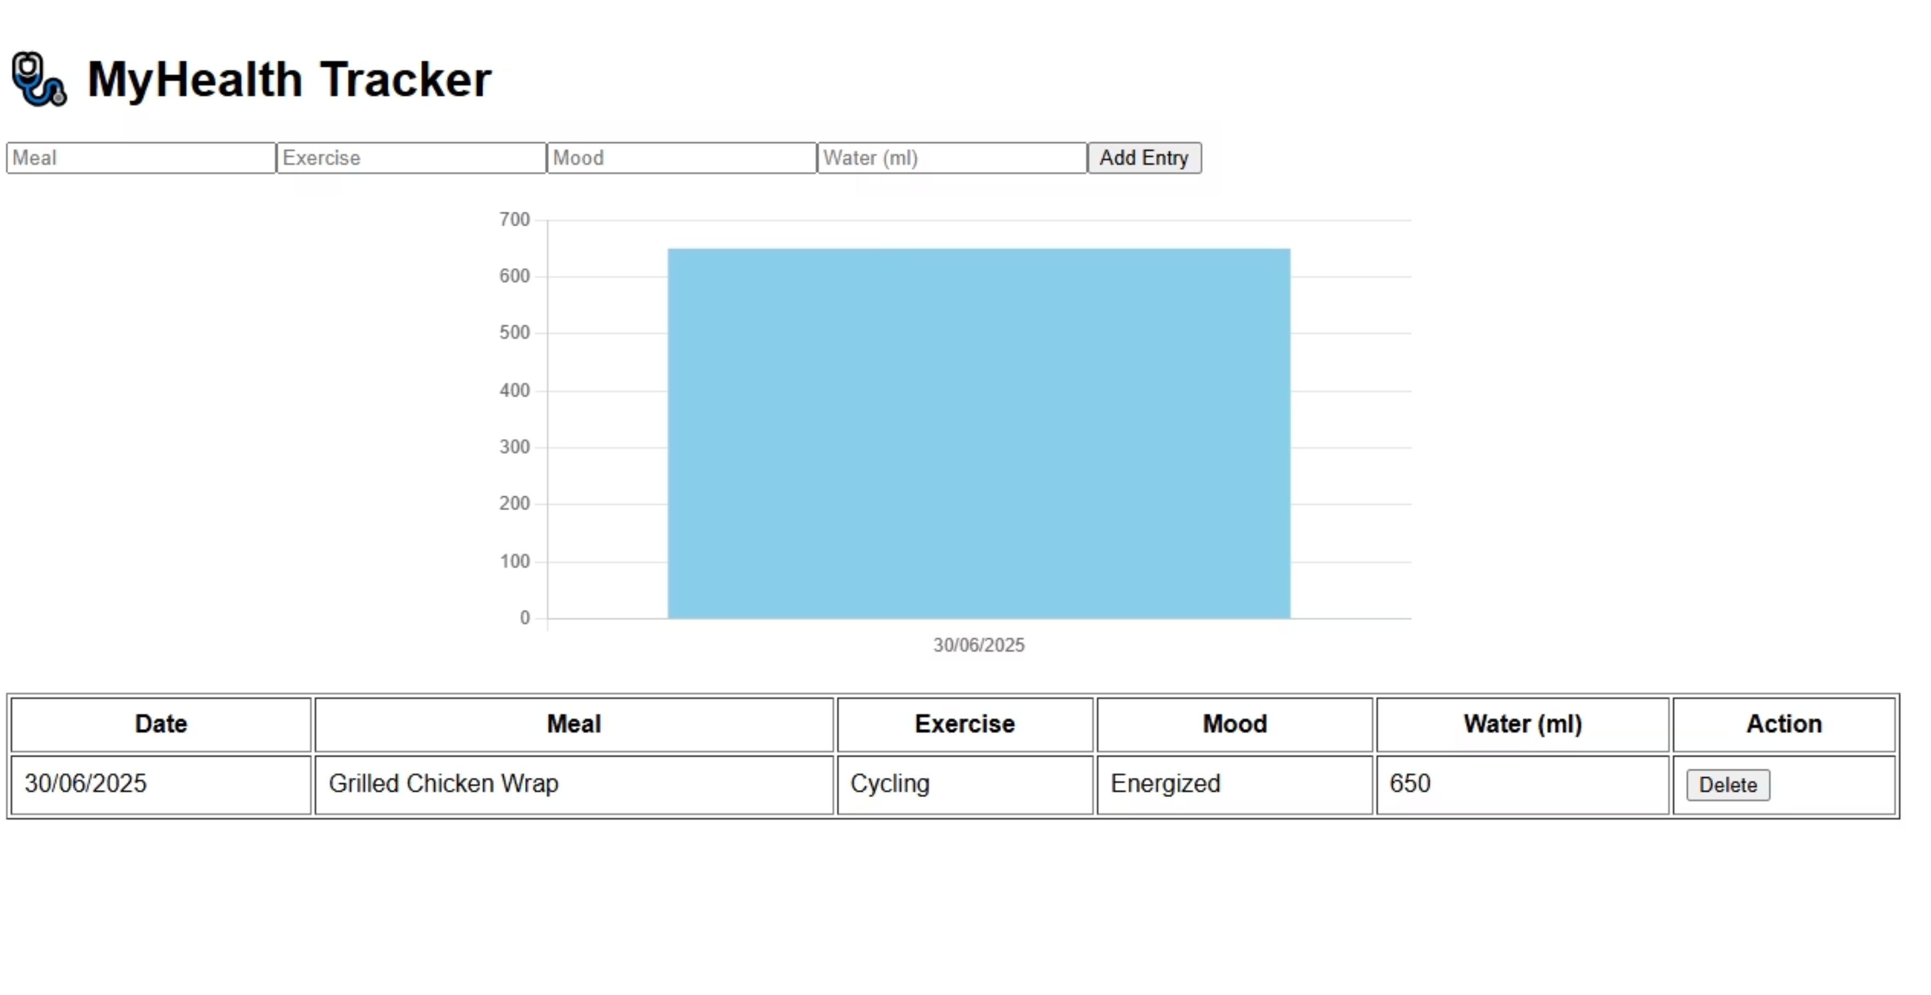
Screenshots from the App (cont.)
Table view:

Slide 8
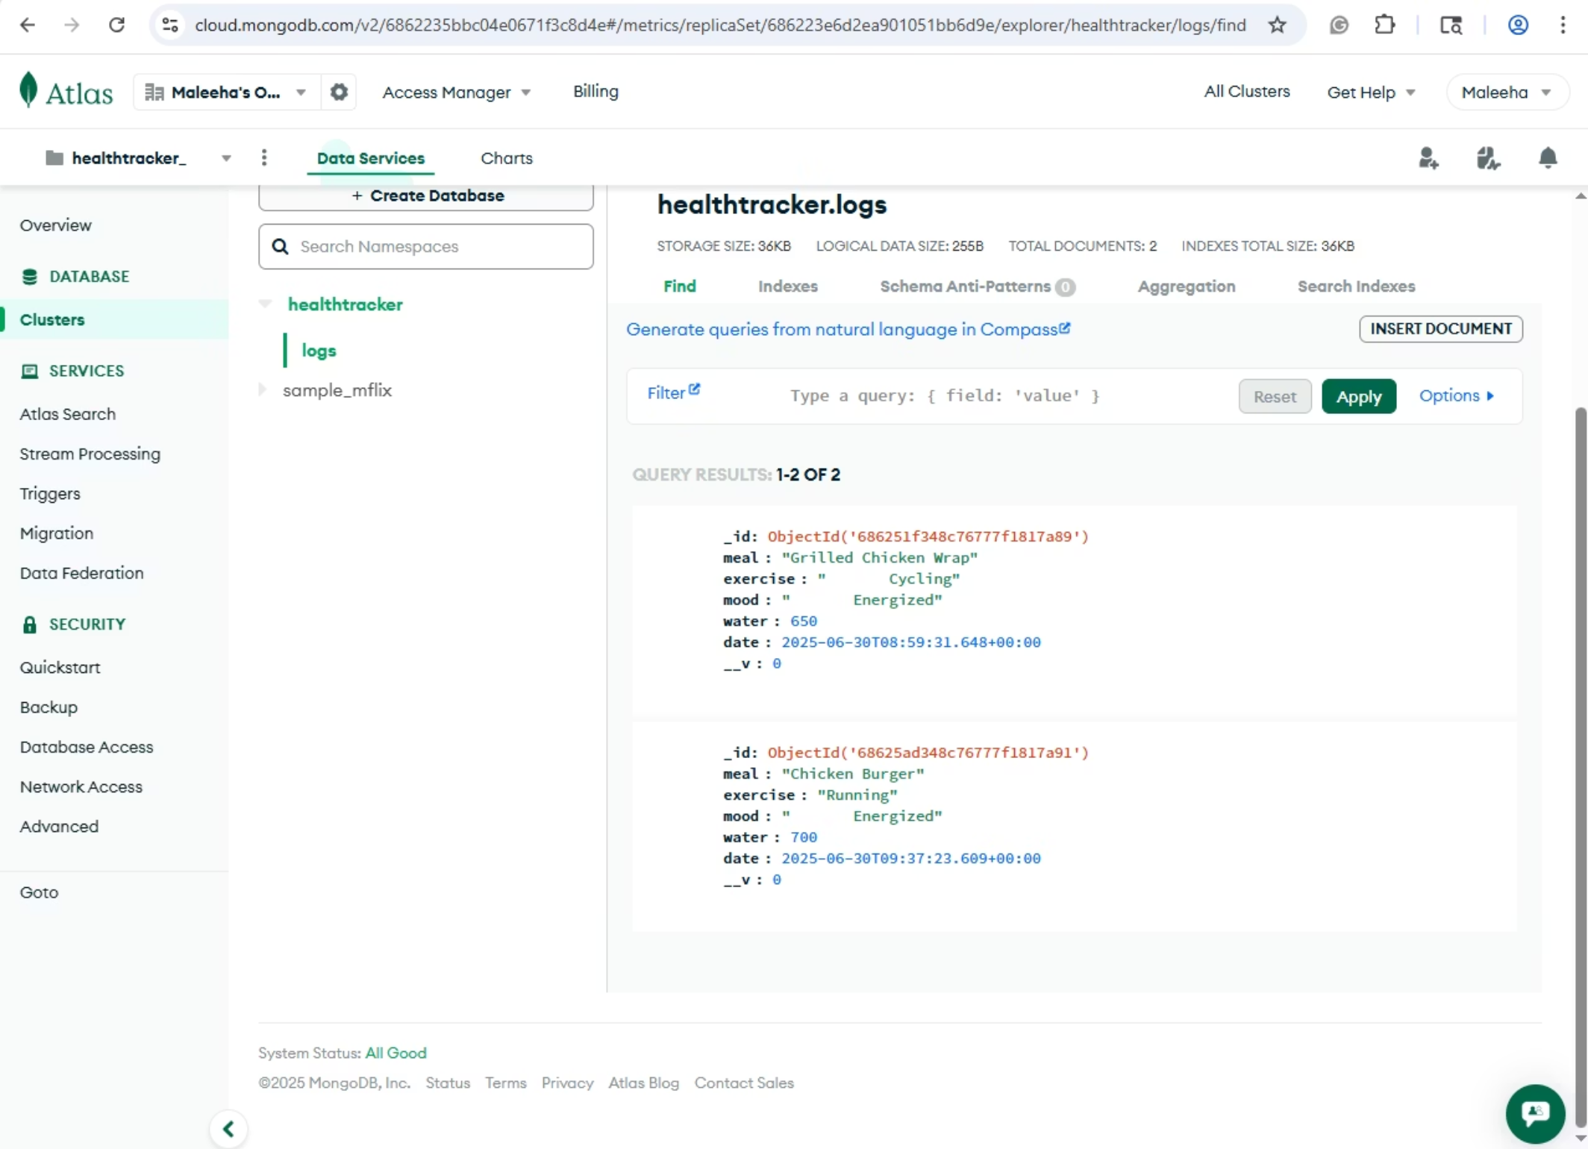
Screenshots from the App (cont.)
MongoDB Atlas showing saved data:

